Slide 1
Final Project Presentation
Group 14
April 20, 2016
Walker Maychek
Ilana Wasserman

Slide 2
Project purpose
Imagine that you are a music producer and want to remix a track, but you cannot find the individual components – like the instrumentals or vocals
Layers is an open source, collaborative platform where every track (“layer”) has direct references to each of its subcomponent layers
Users can upload layers to the website, and can see and download any other layer
Can then modify layer on outside applications
When repost, can link it to the layers from which it came to create a “family history” of the layer

Slide 3
Technical specifications
(“N-M”)EAN stack
Node-MySQL
Express
Angular.js
Node.js
Given the structure of our data, and the relationships between layers, users, hashtags, and links, it made sense to use a relational database where relationships are easily formed as opposed to a NoSQL model

Slide 4
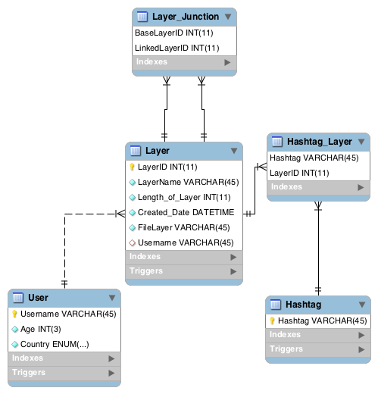
EER Diagram

Slide 5
User interactions
Begin
View, add, or update layer?
Add
View
Update
Username in db?
Search by layer fields to views layers; leave search fields empty to view all.
No
Updates layer; chooses layer, modifies details, and clicks update.
Create new user. User saved in db.
Yes
Adds layer; enters layer details and clicks “Add”.
1
2
End

Slide 6
User interactions (Cont.)
1
Modify Hashtags or Links?
Hashtag
Link
Add or Delete Hashtag?
Neither
Add Linked Layer?
2
Add
Delete
Add
Add Hashtag to list. Hashtag Layer created in db.
Delete Hashtag. Deletes Hashtag Layer from db.
Add Linked Layer to list. Layer Junction created in db.
2

Slide 7
Demonstration

